Slide 1
Operating Systems
Deadlocks

Slide 2



The Deadlock Problem
A set of processes is deadlocked:
if each process in the set is waiting for an event that only another process in the set can cause.
all processes are waiting, none of them cause wakeup event.
Example 1 Example 2
System has 2 disk drives P₁ and P₂ each hold one disk drive and each needs another one.
Mutex A and B, initialized to 0
P P
0 1
Mutex_lock (A); Mutex_lock (B);
Mutex_lock(B); Mutex_lock (A) ;

Slide 3

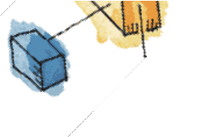
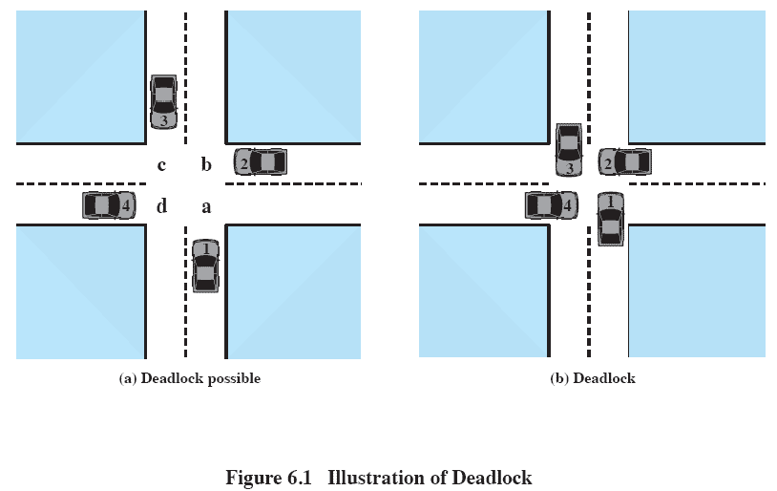
Deadlock

Slide 4
Resource-Allocation Graph
A set of vertices V and a set of edges E.
V is partitioned into two types:
P = {P₁, P₂, …, P_{n}}, the set consisting of all the
processes in the system
R = {R₁, R₂, …, R_{m}}, the set consisting of all
resource types in the system
request edge – directed edge P_{i} → R_{j}
assignment edge – directed edge R_{j} → P_{i}

Slide 5
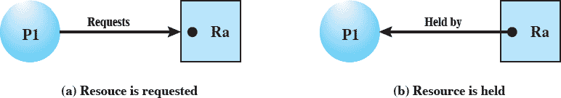
Resource Allocation Graphs
Directed graph that depicts a state of the system of resources and processes
request edge
assignment edge

Slide 6
Resource-Allocation Graph
Process
Resource Type with 4 instances
P_{i} requests instance of R_{j}
P_{i}
R_{j}
P_{i} is holding an instance of R_{j}
P_{i}
R_{j}

Slide 7
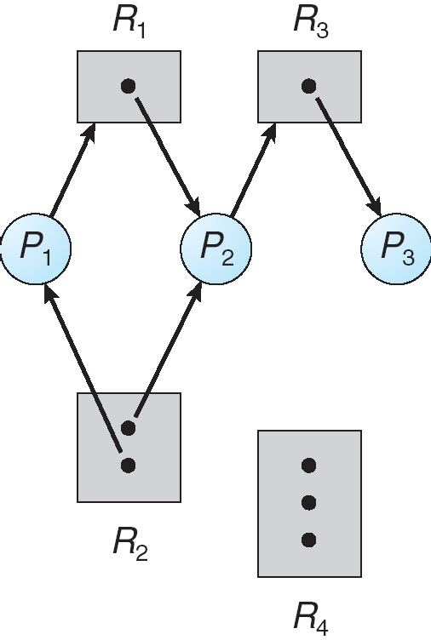
Example of a Resource Allocation Graph

Slide 8
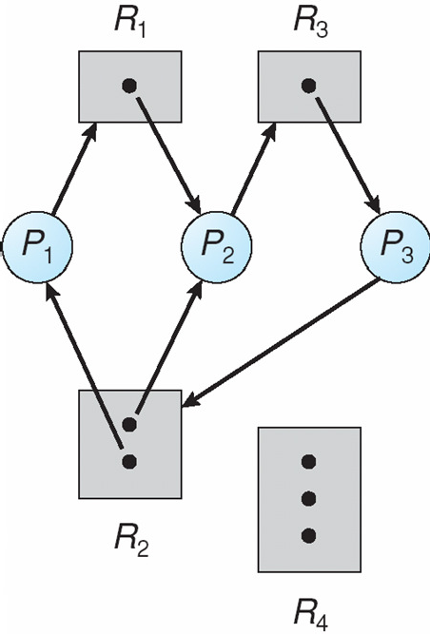
Resource Allocation Graph With A Deadlock

Slide 9
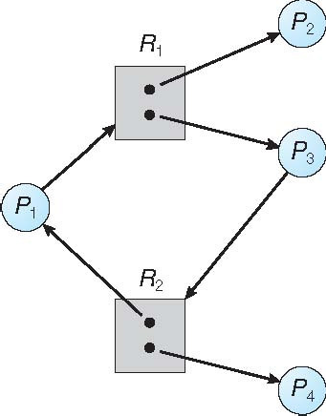
Graph With A Cycle But No Deadlock

Slide 10
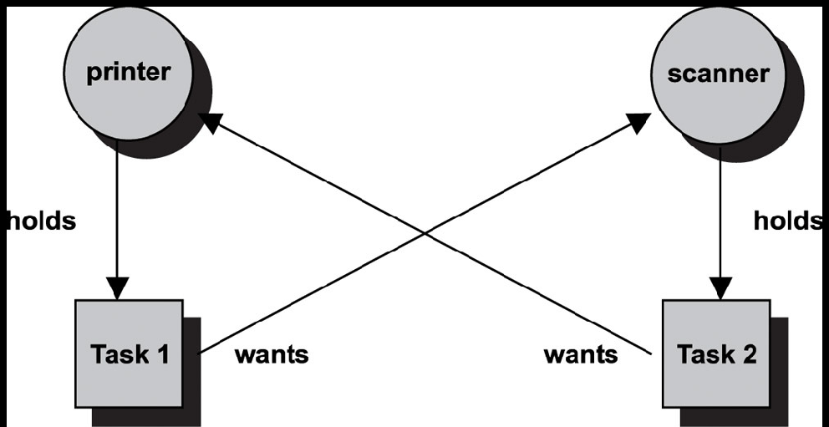
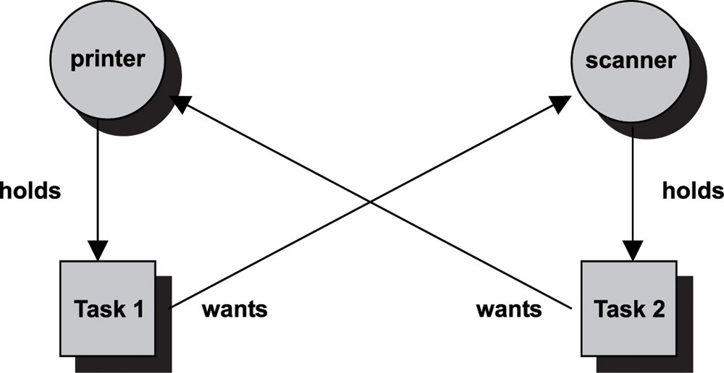
Conditions for Deadlock
Mutual exclusion
Only one process may use a resource at a time
Hold-and-wait
A process may hold allocated resources while awaiting assignment of others

Slide 11
Conditions for Deadlock
No preemption
No resource can be forcibly removed form a process holding it.
Circular wait
A closed chain of processes exists, such that each process holds at least one resource needed by the next process in the chain.

Slide 12
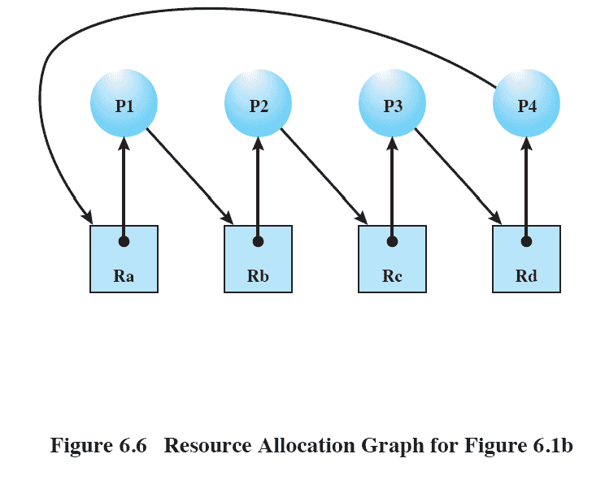
Resource Allocation Graphs
Circular Wait

Slide 13
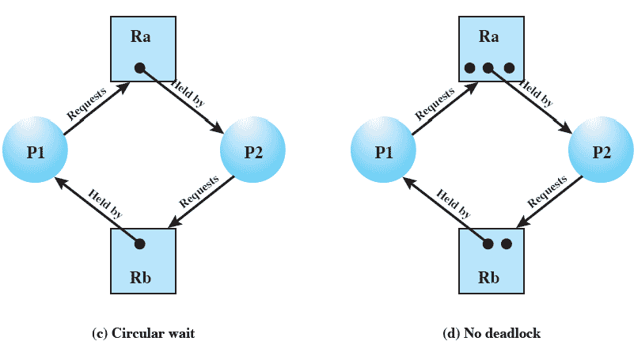
Deadlock Must Occurs:
– all four of these conditions are present.

Slide 14

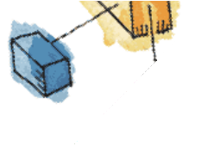
Basic Facts
If graph contains no cycles ⇒ no deadlock
If graph contains a cycle ⇒
– if only one instance per resource type,
then deadlock
– if several instances per resource type, possibility of deadlock

Slide 15
Methods for Handling Deadlocks
Ensure that the system will never enter a deadlock state
deadlock prevention, deadlock avoidance
Allow the system to enter a deadlock state and then recover
detect a deadlock and recover
Ignore the problem and pretend that deadlocks never occur in the system;
used by most operating systems, including Linux and windows

Slide 16
Deadlock Prevention
Restrain the ways request can be made
Mutual Exclusion
Must hold for non-sharable resources
Printer can not be simultaneously shared by several processes
Hold and Wait – must guarantee
a requested process must not hold any other resources
Maintain protocols (next slides)

Slide 17
Hold & Wait Protocols
1
Process must be allocated all its requested resources before it begins execution,
OR
2
Allow process to request resources only when the process has none

Slide 18
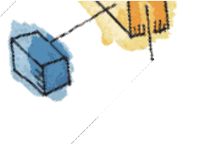



Example Problem
Copies data from a DVD drive to a file on
Protocols
disk, sorts the file, and then prints the
results to a printer.
Request: DVD drive, disk file, printer
Holding the printer for entire execution although it needs only at the end
1
Request 1: Copy file from DVD drive to disk then release.
Request 2: Copy file Disk to Printer and then release
2
Disadvantages: i) low resource utilization (allocated but not used)
ii) Starvation: may have to wait for popular resources

Slide 19

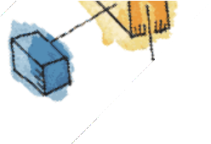
Deadlock Prevention (Cont.)
R_{k}
Preemption
x
R_{i}
x
P starts execution after
P
gaining all R R R
Not going to assign immediately
i k j
R_{j}
Preempted resources are added to the list of resources for which the process is waiting
Process will be restarted only when it can regain its old resources, as well as the new ones that it is requesting

Slide 20

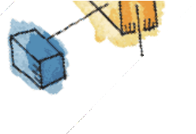


Deadlock Prevention (Cont.)
Circular Wait – Resource will be allocated in increasing order.
F(tape drive) =1
F: R N
F(disk drive) =5
F(printer) =12
Ri < Rj < Rk
P requests R_{j} only when F(R_{j})>F(R_{i})
R_{k}
x
R_{i}
P
P requests R_{j} only when it released F(R_{k})>=F(R_{j})
R_{j}

Slide 21

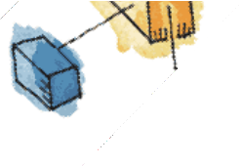
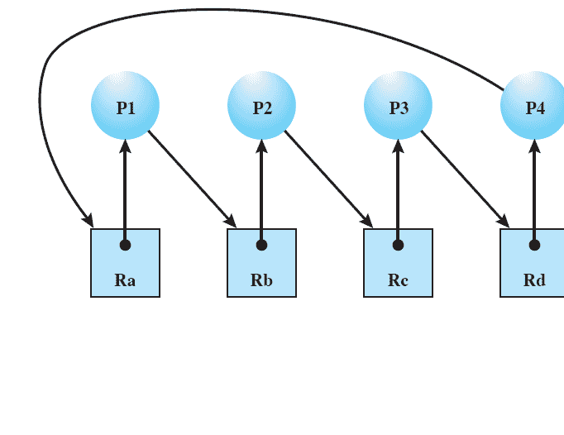
Proof: Circular wait will not occur if the two conditions hold
Proof by Contradiction
Lets circular wait exits for {P₀, P₁, P₂ … P_{n}}
– P_{i} waits for R_{i}, and R_{i} holds by process P_{i+1} and it continues till P_{n} waiting for P₀’s resource R₀.
Hence, P_{i+1} holds resource R_{i} and requested R_{i+1}
F(R_{i})<F(R_{i+1}) for all i
But it means
F(R₀)<F(R₁)<F(R₂)<F(R₃)< …..< F(R_{n})<F(R₀)
By transitivity F(R₀)<F(R₀) which is impossible No Circular Wait- Proved

Slide 22

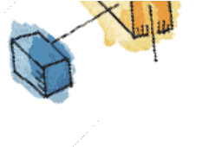
Problem in Deadlock Prevention Protocols
Low device utilization
Reduce system throughput
– Deadlock avoidance

Slide 23

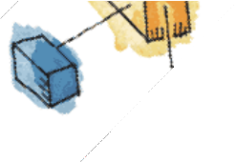
Deadlock Avoidance
A decision is made dynamically whether
the current resource allocation request (if granted), leads to a deadlock ??
Requires:
knowledge of future process requests

Slide 24

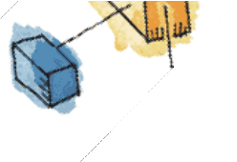
Deadlock Avoidance Algorithm
Dynamically examines the resource allocation state – and ensure, there can never be a circular-wait condition
– the state is safe.
Resource Allocation State:
– # of available & allocated maximum demand
resources and

Slide 25


Safe State
Allocate resources to each process (up to its maximum demand) in some order and avoid deadlock.
Holds a safe sequence <P₁, P₂, …, P_{n}>

Slide 26
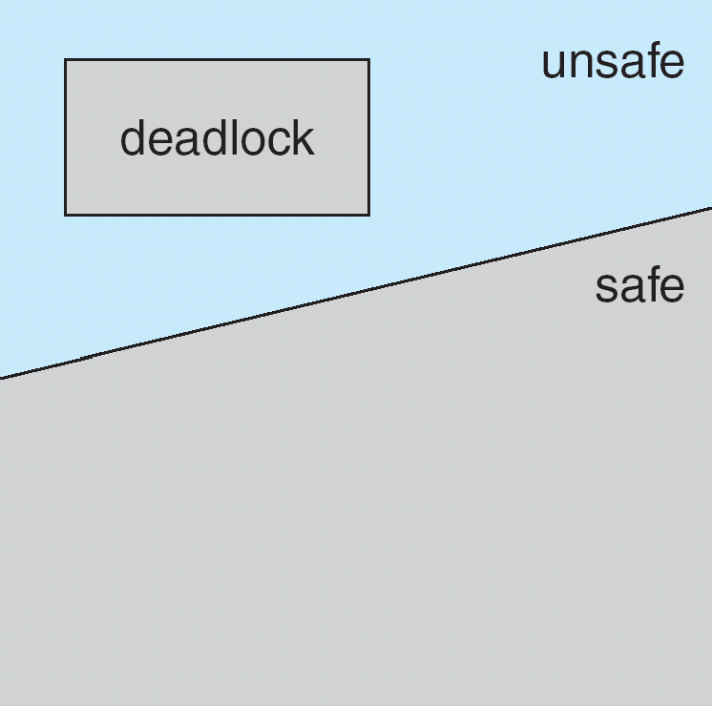
Safe, Unsafe, Deadlock State
A safe is not a deadlock state
A deadlock state is in unsafe state
Not all unsafe states are in deadlock.
However, unsafe state may lead to a deadlock.

Slide 27
Safe, Unsafe, Deadlock State
Maximum Need Current Need
P₀ 10 5
P₁ 4 2
P₂ 9 2
.
Consider the system has twelve magnetic tape drives.
What will happen if P2 requests and is allocated one more tape drive?

Slide 28


Avoidance algorithms
Single instance of a resource type
–Use a resource-allocation graph
Multiple instances of a resource type
– Use the banker’s algorithm

Slide 29


Resource-Allocation Graph Scheme
Claim edge P_{i} → R_{j} indicated that process P_{i} may request resource R_{j}; [represented by a dashed line]
Claim edge converts to request edge when a process requests a resource
Request edge converted to an assignment edge when the resource is allocated to the process
When a resource is released by a process, assignment edge reconverts to a claim edge
Resources must be claimed a priori in the system

Slide 30
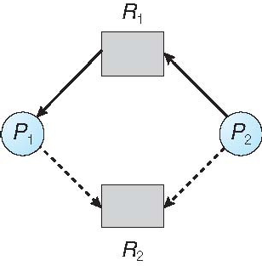
Resource-Allocation Graph

Slide 31
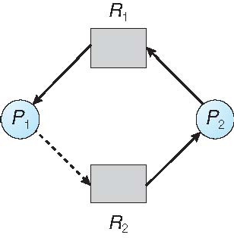
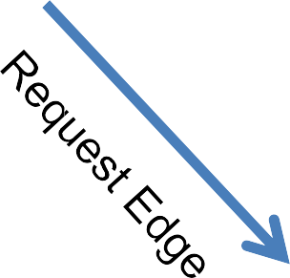
Unsafe State In Resource-Allocation Graph
May Have Deadlock (in future)

Slide 32

Resource-Allocation Graph Algorithm
Suppose process P_{i} requests a resource R_{j}
The request can be granted only if
– converting the request edge to an assignment edge does not result in the formation of a cycle in the
resource allocation graph.
If no cycle exists, the allocation of the resource will leave the system in a safe state
If cycle found, the allocation of the resource will leave the system in an unsafe state. Thus wait for the request to satisfy.

Slide 33

Banker’s Algorithm
Multiple instances
Each process must a priori claim maximum use
When a process requests a resource it may have to wait
When a process gets all its resources it must return them in a finite amount of time

Slide 34
Data Structures for the Banker’s Algorithm
Let n = number of processes, and m = number of resource types.
Available: Vector of length m. If available [j] = k, there are k instances of resource type R_{j} available
Max: n x m matrix. If Max [i,j] = k, then process P_{i} may request at most k instances of resource type R_{j}
Allocation: n x m matrix. If Allocation[i,j] = k then P_{i} is currently allocated k instances of R_{j}
Need: n x m matrix. If Need[i,j] = k, then P_{i} may need k
more instances of R_{j} to complete its task
Need [i,j] = Max[i,j] – Allocation [i,j]

Slide 35
Safety Algorithm
Let Work and Finish be vectors of length m and n, respectively. Initialize:
Work = Available
Finish [i] = false for i = 0, 1, …, n- 1
Find an i such that both:
Finish [i] = false
Need_{i} ≤ Work
If no such i exists, go to step 4
Work = Work + Allocation_{i} Finish[i] = true
go to step 2
If Finish [i] == true for all i, then the system is in a safe state

Slide 36
Example of Banker’s Algorithm
5 processes P₀ through P₄; 3 resource types:
A (10 instances), B (5 instances), and C (7 instances)
Snapshot at time T₀:
 | Allocation | Max | Available
 | A B C | A B C | A B C
P₀ | 0 1 0 | 7 5 3 | 3 3 2
P₁ | 2 0 0 | 3 2 2
P₂ | 3 0 2 | 9 0 2
P₃ | 2 1 1 | 2 2 2
P₄ | 0 0 2 | 4 3 3

Slide 37
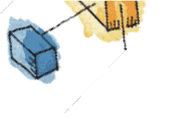
Example (Cont.)
The content of the matrix Need is defined to be Max
– Allocation
Need A B C
P₀ | 7 4 3
P₁ | 1 2 2
P₂ | 6 0 0
P₃ | 0 1 1
P₄ | 4 3 1
The system is in a safe state since the sequence <
P₁, P₃, P₄, P₂, P₀> satisfies safety criteria

Slide 38
Example: P₁ Request (1,0,2)
Check that Request ≤ Available (that is, (1,0,2) ≤ (3,3,2) ⇒ true
 | Allocation | Need | Available
 | A B C | A B C | A B C
P₀ | 0 1 0 | 7 4 3 | 2 3 0
P₁ | 3 0 2 | 0 2 0
P₂ | 3 0 2 | 6 0 0
P₃ | 2 1 1 | 0 1 1
P₄ | 0 0 2 | 4 3 1
Executing safety algorithm shows that sequence < P₁, P₃, P₄, P₀, P₂> satisfies safety requirement
Can request for (3,3,0) by P₄ be granted?
Can not be granted(un-available resource)
Can request for (0,2,0) by P₀ be granted?
Can not be granted (unsafe state)

Slide 39
Resource-Request Algorithm for Process P_{i}
Request = request vector for process P_{i}. If Request_{i} [j] = k then process P_{i} wants k instances of resource type R_{j}
If Request_{i} ≤ Need_{i} go to step 2. Otherwise, raise error condition, since process has exceeded its maximum claim
If Request_{i} ≤ Available, go to step 3. Otherwise P_{i} must wait, since resources are not available
Pretend to allocate requested resources to P_{i} by modifying the state as follows:
Available = Available – Request; Allocation_{i} = Allocation_{i} + Request_{i}; Need_{i} = Need_{i} – Request_{i};
Go for safety algorithm
If safe ⇒ the resources are allocated to Pi
If unsafe ⇒ Pi must wait, and the old resource-allocation state is restored

Slide 40
Deadlock Detection
Allow system to enter deadlock state
Detection algorithm
Recovery scheme

Slide 41
Single Instance of Each Resource Type
Maintain wait-for graph
Nodes are processes
P_{i} → P_{j} if P_{i} is waiting for P_{j}
Periodically invoke an algorithm
searches for a cycle in the graph.
If there is a cycle, there exists a deadlock.
An algorithm to detect a cycle in a graph requires an order of n² operations, where n is the number of vertices in the graph

Slide 42
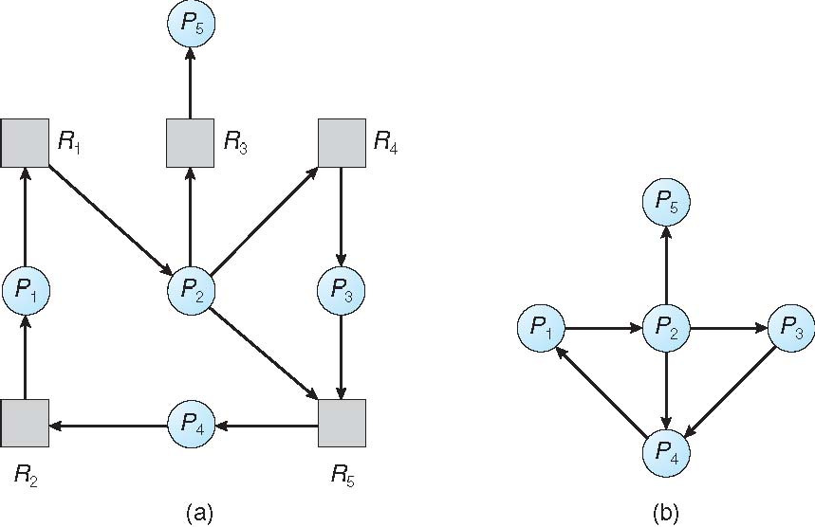
Resource-Allocation Graph and Wait-for Graph
Resource-Allocation Graph
Corresponding wait-for graph

Slide 43
Several Instances of a Resource Type
Available: A vector of length m indicates the number of available resources of each type.
Allocation: An n x m matrix defines the number of resources of each type currently allocated to each process.
Request: An n x m matrix indicates the current request of each process. If Request [i][j] = k, then process P_{i} is requesting k more instances of resource type R_{j}.

Slide 44
Detection Algorithm
Let Work and Finish be vectors of length m
and n, respectively Initialize:
Work = Available
For i = 1,2, …, n, if Allocation_{i} ≠ 0, then
Finish[i] = false; otherwise, Finish[i] = true
Find an index i such that both: (a)Finish[i] == false (b)Request_{i} ≤ Work
If no such i exists, go to step 4

Slide 45
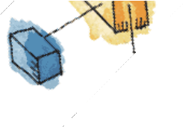
Detection Algorithm (Cont.)
3.Work = Work + Allocation_{i} Finish[i] = true
go to step 2
4.If Finish[i] == false, for some i, 1 ≤ i ≤ n, then the system is in deadlock state.
Moreover, if Finish[i] == false, then P_{i} is deadlocked
Algorithm requires an order of O(m x n²⁾ operations to detect whether the system is in deadlocked state

Slide 46
Example of Detection Algorithm
Five processes P₀ through P₄; three resource types A (7 instances), B (2 instances), and C (6 instances)
Snapshot at time T₀:
Allocation Request Available
 | A B C | A B C | A B C
P₀ | 0 1 0 | 0 0 0 | 0 0 0
P₁ | 2 0 0 | 2 0 2
P₂ | 3 0 3 | 0 0 0
P₃ | 2 1 1 | 1 0 0
P₄ | 0 0 2 | 0 0 2
Sequence <P₀, P₂, P₃, P₁, P₄> will result in Finish[i] = true for all i

Slide 47
Example (Cont.)
P₂ requests an additional instance of type C
Request A B C
P₀ | 0 0 0
P₁ | 2 0 2
P₂ | 0 0 1
P₃ | 1 0 0
P₄ | 0 0 2
State of system?
Can reclaim resources held by process P₀, but insufficient resources to fulfill other processes; requests
Deadlock exists, consisting of processes P₁, P₂, P₃, and P₄

Slide 48
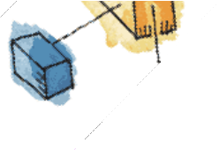
Detection-Algorithm Usage
When, and how often, to invoke depends on:
How often a deadlock is likely to occur?
How many processes will need to be rolled back?
one for each disjoint cycle
If detection algorithm is invoked arbitrarily, there may be many cycles in the resource graph and so we would not be able to tell which of the many deadlocked processes “caused” the deadlock.

Slide 49
Recovery from Deadlock: Process Termination
Abort all deadlocked processes
Abort one process at a time until the deadlock cycle is eliminated
In which order should we choose to abort?
Priority of the process
How long process has computed, and how much longer to completion
Resources the process has used
Resources process needs to complete
How many processes will need to be terminated
Is process interactive or batch?

Slide 50
Recovery from Deadlock: Resource Preemption
Selecting a victim – minimize cost
Rollback – return to some safe state, restart process for that state
Problem:
starvation
same process may always be picked as victim, include number of rollback in cost factor.

Slide 51

Chapter 8
Reading 8.1-8.6
Operating System Concepts – 8th Edition
Silberschatz, Galvin and Gagne ©2009

Slide 52
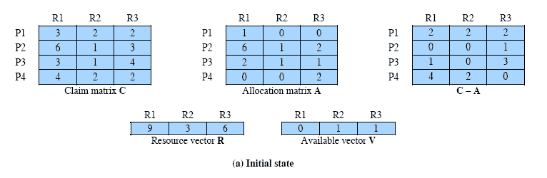
Determination of a Safe State

Slide 53
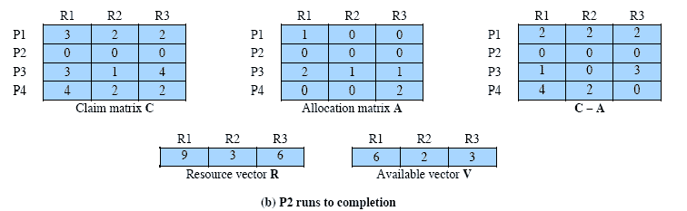
Determination of a Safe State

Slide 54
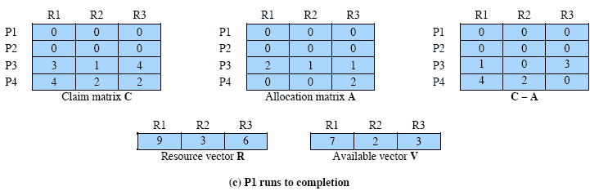
Determination of a Safe State

Slide 55

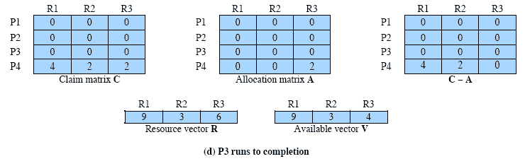
Determination of a Safe State

Slide 56

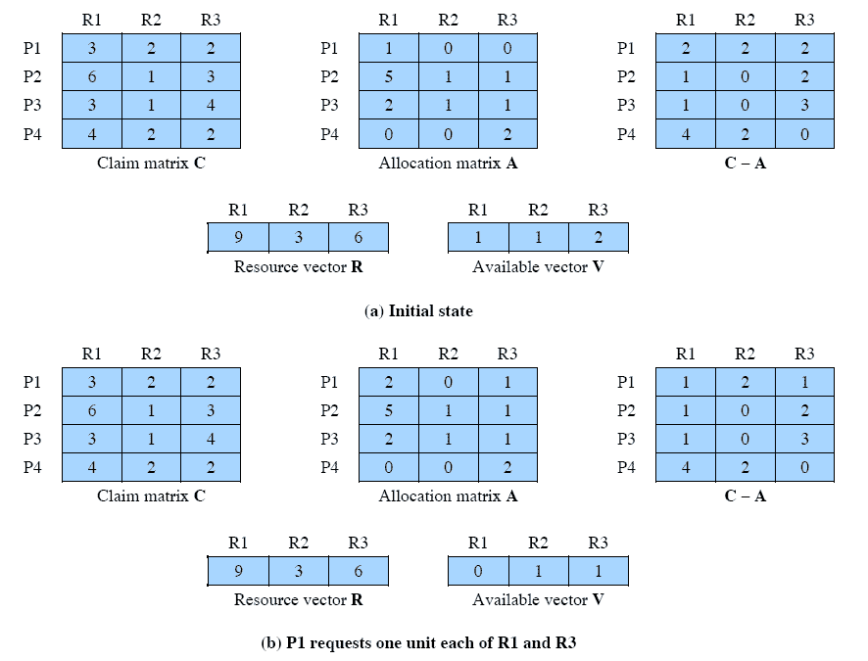
Determination of an Unsafe State

Slide 57

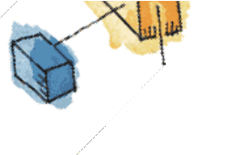
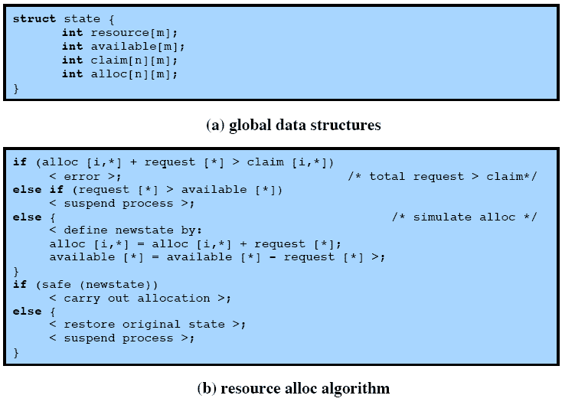
Deadlock Avoidance Logic

Slide 58

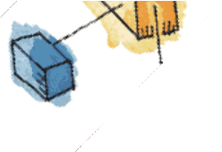
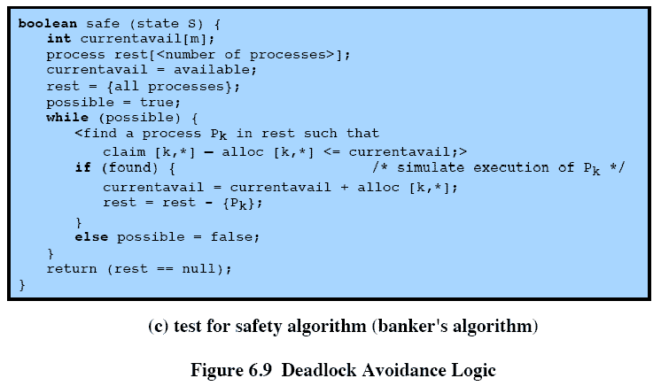
Deadlock Avoidance Logic

Slide 59

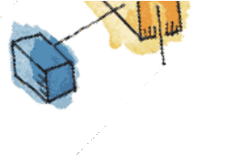
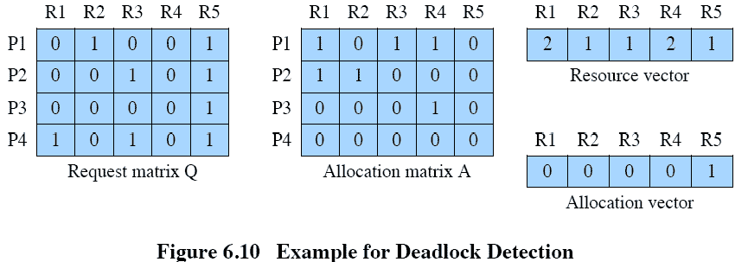
Deadlock Detection

